Slide 1
Data warehouse
Schemas

Slide 2
Data warehouse development
Data warehouse development approaches aim to create an infrastructure that supports all the information business needs.
Inmon Model: EDW approach (top-down)
Kimball Model: Data mart approach (bottom-up)
Which model is best?

Slide 3
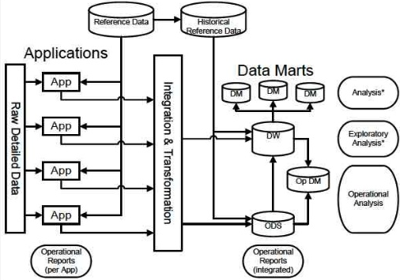
Inmon’s Corporate Information Factory
Create a data model of all business data and use this to create an EDW (enterprise data warehouse)
Use the EDW to feed data marts, CRMs etc
Uses traditional database methods and techniques to develop the EDW
Fully normalised EDW is required

Slide 4
Kimball’s Business Dimensional Lifecycle
Identify information requirements and associated business processes of the enterprise and create the Data Warehouse Bus Matrix
Lists the key business processes with an indicator of analysis
Facilitates the selection and development of the first database (data mart)
The integration of further data marts leads to the EDW
Uses dimensionality modeling to establish the data model
The use of star schemas is an intuitive way to model decision support data and enhance performance for complex analytical queries.

Slide 5
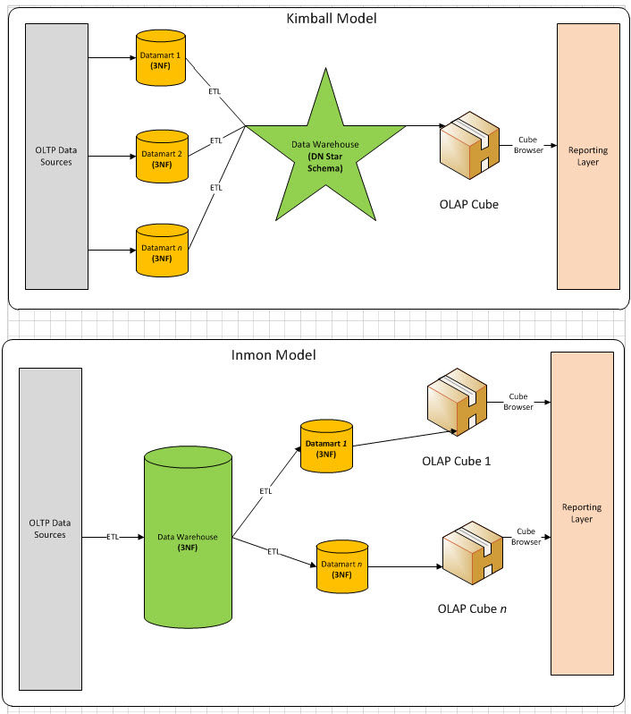
Kimball vs Inmon
Top-down (Inmon) vs Bottom-up (Kimball)
Kimball:
Data marts
Logical data warehouse
Decentralised
Quick results, iterative approach
Inmon:
Enterprise data model
Centralised
Later create data marts
More upfront work, but less repetitive work

Slide 6
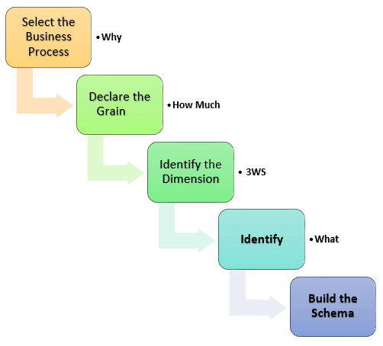
Steps of Dimensional Modelling - Kimball model
Identify Business Process
Identify Grain (level of detail)
Identify Dimensions
Identify Facts
Build Star

Slide 7
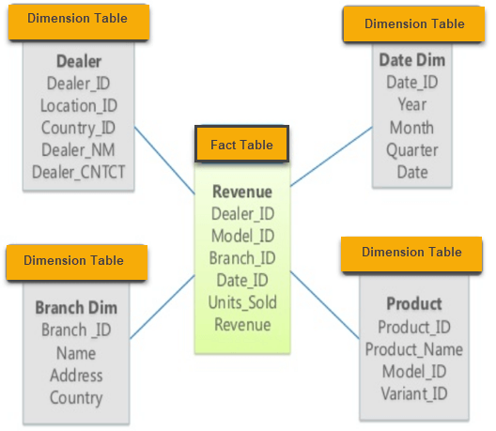
Star Schema
Has one fact table and a number of associated dimension tables.
The star schema is the simplest type of Data Warehouse schema.

Slide 8
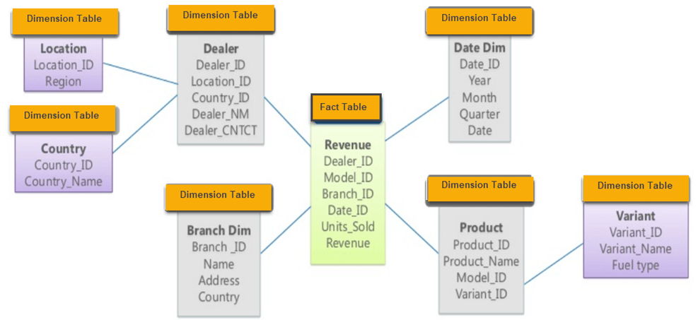
Snowflake Schema

Slide 9
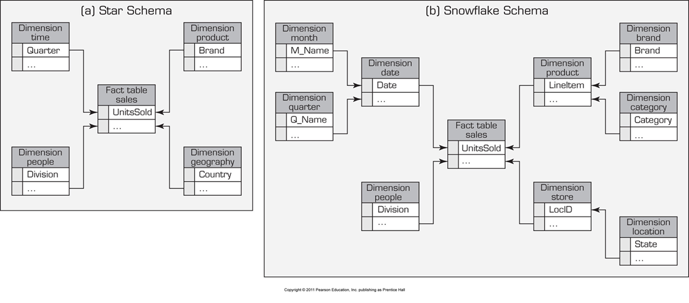
Star vs Snowflake Schema

Slide 10
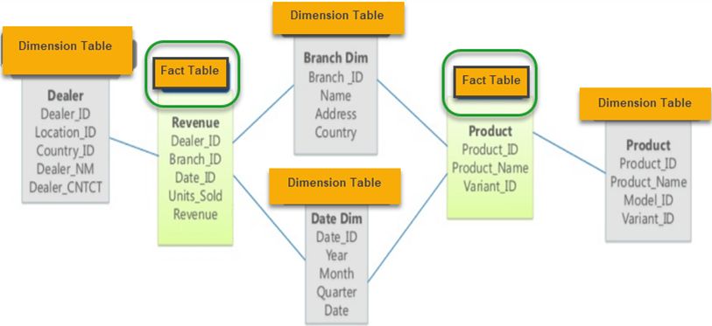
Constellation Diagram

Slide 11
Optimising Schema Performance
There are 4 main techniques used for optimisation of a data warehouse design
Normalising dimensional tables
Having multiple fact tables to represent different aggregation levels
De-normalising fact tables
Partitioning and replicating tables

Slide 12
Analysis of Data in DW
OLTP vs. OLAP…
OLTP (Online Transaction Processing)
Capturing and storing data from ERP, CRM, POS, …
The main focus is on efficiency of routine tasks
OLAP (Online Analytical Processing)
Converting data into information for decision support
Data cubes, drill-down / rollup, slice & dice, …
Requesting ad hoc reports
Conducting statistical and other analyses
Developing multimedia-based applications

Slide 13
OLAP Operations
Slice - a subset of a multidimensional array
Dice - a slice on more than two dimensions
Drill Down/Up - navigating among levels of data ranging from the most summarized (up) to the most detailed (down)
Roll Up - computing all of the data relationships for one or more dimensions
Pivot - used to change the dimensional orientation of a report or an ad hoc query-page display

Slide 14
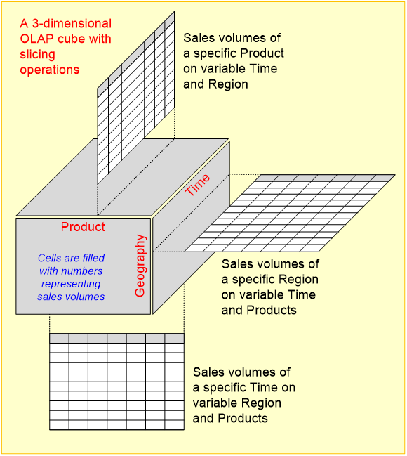
OLAP
Example:
Slicing Operations on a Simple Tree-Dimensional Data Cube

Slide 15
KFC DRINK RESALES IN THE WORLD

